Slide 1

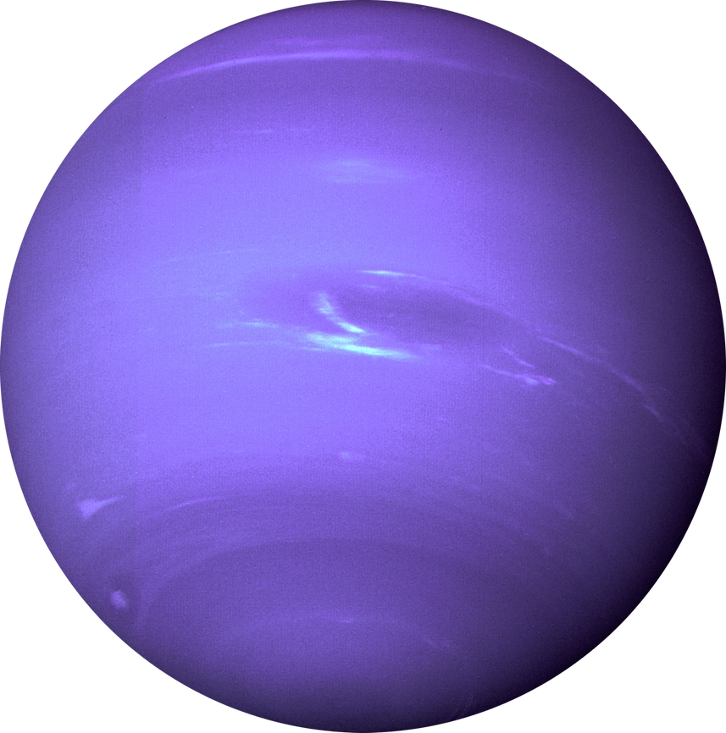
ELEMENT SPACE
Planets
Astronomy
Space
DATA VISUALIZATION OF NASA'S EYE ON ASTEROID DATASET
TEAM MEMBERS
SAHANA M [20201ISE0011]
KAVYA J [20201ISE0044]
DHANUSHA A [20201ISB0005]

Slide 2


PROBLEM STATEMENT
Detecting Hazardous Asteroids
Identify potentially dangerous asteroids that could pose a threat to Earth and develop strategies for deflection or mitigation.
Mapping Asteroid Populations
Accurately map the distribution and characteristics of asteroids in our solar system to improve our understanding of their origins and behavior.
Studying Asteroid Composition
Analyze the chemical and physical properties of asteroids to uncover insights into the formation and evolution of our planetary system.

Slide 3


ELEMENT SPACE
Planets
Astronomy
Space
MOTIVATION OF TITLE
Advancing Scientific Knowledge
Exploring asteroids provides valuable insights into the origins and history of our solar system, expanding our understanding of the universe and our place within it.
Unlocking Economic Potential
Asteroids may hold valuable resources, such as rare minerals and water, which could be harnessed for future space exploration and resource extraction.
Safeguarding Our Planet
Asteroid monitoring and study is crucial for identifying and mitigating potential threats to Earth, ensuring the long-term safety and survival of our planet.

Slide 4



ELEMENT SPACE
Planets
Astronomy
Space
Dataset used for visualization
NASA’S eye on asteroids.csv
THIS DATASET AIMS TO PROVIDE A COMPREHENSIVE AND
INTERACTIVE PLATFORM FOR VISUALIZING ASTEROID DATA
COLLECTED BY NASA.
THROUGH THIS PROJECT,USERS CAN EXPLORE REAL-TIME INFORMATION ABOUT ASTEROIDS,THEIR SIZE,COMPOSITIONS AND POTENTIAL IMPACT RISKS.
THE VISUALIZATION TOOLS ALLOWA TO TRACK INDIVIDUAL ASTEROIDS,VIEW THEIR ORBITS,AND UNDERSTAND THEIR CHARACTERSTICS.

Slide 5
Algorithm
Pandas library - To work with dataset .It has functions for analyzing,cleaning,exploring and manipulating data
Matplotlib - Matplotlib is a popular Python library for creating static, animated, and interactive visualizations in Python
Plotly: Plotly is another Python library that offers interactive data visualization capabilities. It allows users to create interactive plots, charts, and dashboards, which can be useful for exploring complex asteroid datasets
Seaborn: Seaborn is a Python visualization library based on Matplotlib, providing a high-level interface for creating attractive and informative statistical graphics.

Slide 6



ELEMENT SPACE
Planets
Astronomy
Space
THANK YOU
For Your Attention

